Slide 1
FHWA-NHI-420047
Instructor Development Course for
Web Conference Training (WCT)
Module 3: Effective WCT Instruction
Notes:
Layout for 10 minutes prior to course start: Course Introduction
Layout for Presentation: Presentation Layout
Welcome back! Let’s get started with Module 3: Effective WCT Instruction.
Facilitator Note: Address any of the comments/questions/concerns from Module 2. To transition to Module 3, reference the Notes pod that contains the list of things participants wanted to learn in this course and point out any that will be covered during this module.
This module combines the tools you learned about in Modules 1 and 2 with effective presentation techniques in a WCT setting. Now that you are familiar with the tools and the technology used to deliver WCT instruction, we can delve into different ways to present information and helpful dos and don’ts for a WCT environment.

Slide 2
NHI Web Conference Training: Getting Started Module 3
Learning Outcomes
By the end of this module, you will be able to:
Understand the skillset necessary to effectively deliver WCT.
Thoroughly and effectively prepare for a WCT course.
Prepare an accurate checklist of necessary items/equipment needed for WCT class.
Identify a variety of vocal tips and techniques to improve instructor delivery.
Interact/connect with and draw out your audience by utilizing a diverse blend of questions and varying skillsets.
Recognize the key characteristics of effective WCT instructors

Slide 3
Module Topics
Prep
Physical Concerns
Vocal Technique
Instructor Delivery
Audience Interaction
Notes:
This module can be divided into five different sections, with guidelines and examples in each.
Instructor Delivery
Preparation
Physical Concerns
Vocal Technique
Audience Interaction

Slide 4
NHI Web Conference Training: Topic 1-Instructor Delivery
Instructor Delivery
Prep
Physical Concerns
Vocal Technique
Audience Interaction
Notes:
In this topic, we will discuss the instructor skill sets necessary to keep your participants actively engaged and attentive throughout the NHI WCT, what habits to avoid and overall keys to a successful Instructor presentation.

Slide 5
NHI Web Conference Training: Instructor Delivery
Topic One: Instructor Delivery
Instructor Delivery: Key to success
Traditional Classroom Teacher/Tech Support Rep
Engage Students
Spark Curiosity
Organized
Responsive
Polite/Courteous
Patient and Flexible
Goal: Make Web Conference Training Effective/Engaging
Notes:
Instructor Delivery
The Instructors Presentation skills are key to the success of any web based distance learning training program. Some of the
Qualities of A Successful Instructor - (Raths 1999) state that: “Instructors who thrive in the web based classroom, combine skills of a traditional classroom teacher, with that of a technical support representative.” Such an Instructor will engage students, spark their curiosity and are also:
Organized
Responsive
Polite/Courteous
Patient and Flexible
The overall goal is to make the participants Web Conference Training experience more enjoyable, effective and engaging.

Slide 6
NHI Web Conference Training: Instructor Delivery (Continued)
But How???
What other qualities are necessary?
Notes:
What else is needed to keep your participants interactive and engaged? Following the guidelines presented in this module will result in two important benefits for you the Instructor. Your Web Conference Training sessions will be more enjoyable and engaging and you will be effective in informing and educating your audience.

Slide 7
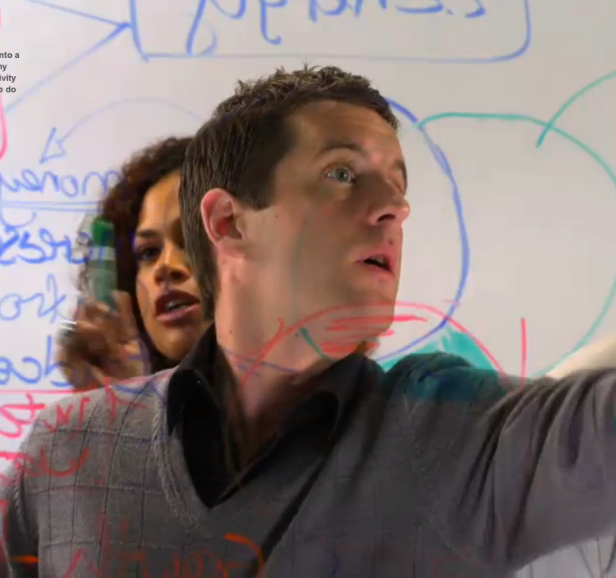
NHI Web Conference Training: Instructor Delivery- Technical Presentations Can Be Engaging
It’s amazing when you look at it…
It doesn’t do what you expect!
The consequences are fascinating!
Notes:
Is the subject matter you teach highly technical in nature? Is it dry, complex, or otherwise not as easy to digest as a PG movie? Probably, but that’s okay because it does not have to be dry.
The best communicators of technical information do it by finding little ways to make the facts interesting. Find a way to personalize the audience's relation to the information. Find a reason to be enthusiastic about the facts. You may want to make notes of anecdotes to share, experiences or examples to provide, or simply ways to break up any potentially monotonous sections of material.
One trick is to get students talking. When participants are actively participating, they are almost automatically engaged. Provide additional discussion questions, ask a student who has been quiet to give their opinion, or maybe just ask how everyone is doing. Letting participants know you care about their well-being can go a long way to engage them in the content.

Slide 8
NHI Web Conference Training: Instructor Delivery (Continued)
Additional Qualities/Skills to Cultivate
Mentor
Effective Communicator
Knowledgeable
Articulate
Professional
Accessible/Available
Supportive
Responsive
Student interaction
Advance preparation
Notes:
Additional qualities/skills to cultivate
A successful WCT Instructor combines mentoring with being an effective communicator and facilitator of knowledge. This dualistic role of the Instructor is vital. Although the Distance Learner is a more self-directed student, they need the assurance that there is a knowledgeable, “live person” available to support them, with the ability to respond in an articulate, professional manner.
In Distance Learning, Instructors will interact more with their students and give more attention to advance preparation of visual materials, activities for independent study and follow-up activities.

Slide 9
NHI Web Conference Training: Instructor Delivery (Continued)
Effective Instructors give individual attention
Instructors and participants always communicate in a
Reflective
Careful
Respectful
Direct
Clear
Understandable manner
Notes:
Instructor Delivery (Continued)
Effective Instructors give individual attention via private messages, email, etc. and provide summarizing comments to keep class moving and conversation on task.
Instructors and participants want to be mindful to always communicate in a, Reflective, Careful, Respectful, Direct, Clear and Understandable manner,
The qualities and various skill sets listed can be demonstrated in your voice inflection, manner of speech and overall delivery. But what about subtle intimations of your audience, obvious in the Instructor Led classroom but unknown/unseen by the Web Conference Trainer?

Slide 10
NHI Web Conference Training: Instructor Delivery (Continued)
Absence of Body Language
No Visual Cues
Notes:
Instructor Delivery (Continued)
One of the downsides to Web Conference Training that you will encounter, is that the ability to take risks, assert oneself “on paper” and be able to present, explain or justify ones perspective, becomes more challenging when body language, eye contact and other visual cues are removed from the scenario. You are not able to see your audience and your audience isn’t able to see you.
But as an instructor you still want to avoid the typical annoying presentation habits common to Instructor Led Training courses. What are some of those annoying habits?

Slide 11
NHI Web Conference Training: Instructor Delivery (Continued)
Which presentation habits annoy you?
Notes:
Facilitator Note: Switch to Discussion Layout and take notes in the Annoying Presentation Habits Chat Pod.
Ask: Which presentation habits annoy you as a listener? Bring up the chat pod. Provide suggestions or write down any of the following if needed.
Example: Do you find yourself tuning out or rolling your eyes when faced with a presenter who:
Reads text directly off the screen
Talks in monotone
Sounds bored
Seems tentative and unsure/lacks confidence
Sounds like he is reading a canned speech
Doesn’t ever interact with the audience
Potential answers:
Hold music
Lack of energy
Reading the slides/reading the bullets
Not being prepared
Ums and uhs
Shallow presentation
No interactivity
Echo or odd audio feedback
We are going to make sure that your audience doesn’t walk away with these feelings after your next WCT!

Slide 12
NHI Web Conference Training: Instructor Delivery (Continued)
Goal: Make You More Comfortable and Confident
Notes:
And you will feel better prepared as an instructor, confident that you can give the same quality presentation to a remote audience that you would give to an in-classroom audience.

Slide 13
NHI Web Conference Training: Topic 2-Preparation
Prep
Instructor Delivery
Physical Concerns
Vocal Technique
Audience Interaction
Notes:
In this topic, we’ll talk about how to prepare to instruct an NHI WCT.
Being an effective presenter starts long before your event. Just as actors rehearse for months before opening night, you need proper preparation to give a great “performance” or instruction.
The technology should seamlessly integrate with your content – when you have an activity, the progression to and from it should not disrupt the instruction. In order to have that effect, you have to be well-versed in the content and software, know what you are going to say, how you are going to control the flow of the room, and how you are going to engage and handle participants, just like in a traditional classroom.

Slide 14
NHI Web Conference Training: Preparation - Using a Script vs. Notes
Beginning/End
Script
Main Body
Bulleted Notes
Notes:
One great way to give yourself a good start, but not fall into the trap of completely reading everything from a script, is to script an opening paragraph or two, and a closing paragraph or two. This helps you start your presentation without fumbling for the right introduction and it makes you end strongly, without forgetting any housekeeping items or calls to action for the audience.
In between, simple bullet points should help you remember your key points without giving you a word for word script. You want to sound like you are having a conversation with your audience, not like you are reading a book to them.

Slide 15
NHI Web Conference Training: Preparation - Shorten Your Introductory Remarks
Notes:
Writing your introduction (script) will help you combat the natural tendency to add too many prefacing remarks. Get to your topic and give the audience something useful and interesting quickly. Your audience knows why they are there; you don’t have to tell them the topic again.
This is something we will practice in Module 5, when you have a chance to practice presenting a WCT. You’ll first give an introduction and we can help you tighten it up if needed.
Let’s take a minute to practice.
Facilitator Notes: Open the Sample Introduction Whiteboard. Give students permission to edit whiteboards. Ask students to work together as a class to edit the introduction down. Provide recommendations as applicable.
Sample Introduction Whiteboard Content:
Let me introduce myself. I am___<<** your name here **>>____, and I'll be your instructor for this
session, which runs from<<** start date **>> through <<** end date **>>.
I work at <<** name of organization, where located, and anything else you'd wish them to know.
**>>
Our “session” will be held “in” the “Adobe Connect” virtual classroom, at:
http://www.connect.dot.com/roomname.
Here’s the basic outline:
• Module A is a kind of introduction, and if you have any other ‘site’ questions, review the Orientation notes at the top of the room.
• By the end of Module A you should have a serious idea about your potential course project.
Some tips are given in documents in the Adobe Connect room, and I’ll be happy to ‘discuss’ ideas with you.
o Your Module A “homework” is to get feedback from me so you can finalize your idea.
o Also, please read the Chat Pod prompts and post something so we can benefit from each other’s thinking.
• After the end of Modules B, C, and D, you’ll gradually fill in the Worksheet (a blank
one is posted in the Adobe Connect Room) and email it to me for feedback. You’ll also have discussion
questions.
• Module E is about ‘reporting’ — it’s important to think about this throughout and then let the
strengths of the Model approach shine in the reporting phase of a project.
• When you have questions, you can post them in the classroom Chat Pod or email me. When I answer your direct questions by email, I’ll post general comments for all participants in the Adobe Connect classroom. It’s important to budget time for this and to keep on task. Work around your own schedule, but don’t demote it to 11th‐most‐important task.
What questions do you have for me before we get started?

Slide 16
NHI Web Conference Training: Preparation - Do Not Read the Slides
Notes:
The instructional designer who designs the course will take special care to not write complete sentences and every detail on the slides, but rather provide bulleted/abbreviated content, graphics or images, or other relevant illustration of content. The horribly designed PowerPoint you see on the screen? This will not be what you receive from NHI as the presentation materials.
Work with the materials. For example, if there is a list on the screen, you may not want to read it to the participants. You may possible want to discuss each one; you may alternatively give students a minute to read through the list themselves and then comment on if they have anything to add.
Using the PowerPoint presentation as a tool instead of a narration script will allow you the freedom to discuss and describe the content in a way that you feel best and most naturally covers the content you need to cover, in a way that flows for you.
Although instructor notes are also provided (as we’ll review and discuss when we look at instructor guides in the next module), these notes describe how to present the content and explain the main purpose of the slide. Your value add as an instructor comes in your expertise of the subject matter – sharing personal experience, examples, or other anecdotal information to reinforce or add to the main points to cover. Make sure you personalize the content so that it is presented in a natural, effective way. It will not be the same for every instructor, but the main content points will always be covered.

Slide 17
NHI Web Conference Training: Preparation - Practice: It Is Not Optional
Notes:
Practice: It is the single most important thing you will do to prepare to instruct a course. Rehearse your instruction, adjust, and rehearse again.
Practicing means delivering the entire presentation, word for word, as if there was an audience listening. It is not sufficient to skim through your slides or instructor manual, confirming that everything looks good and you think you know what you will say when the time comes. Delivering the presentation ahead of time makes you confident and comfortable with segues, timing, and what you will say.

Slide 18
NHI Web Conference Training: Preparation - The Three E’s
The Three E’s:
I have EARNED the right to deliver this material
I am ENTHUASTIC about the material
I am EAGER to share with the audience
Notes:
Check yourself for the three E’s.
I have EARNED the right to deliver this material.
I am ENTHUSIASTIC about the material.
I am EAGER to share with the audience.
Why have you earned the right to deliver the material? Maybe it’s just in the audience’s mind. But you are the authority. Believe it!
Why are you enthusiastic about the subject? Remember what is useful, interesting or beneficial about the material.
Why are you eager to share your information with the audience? How are you helping them?

Slide 19
NHI Web Conference Training: Preparation - Quick Review
Preparation:
Scripting vs. Bullet Points
Introductory Remarks
Using Slide Content Most Effectively
Rehearsing
The Three E’s
Notes:
Let’s take a quick moment to review the points we discussed during preparation.
Facilitator Note: Pull up the Preparation Review Poll Pod. Ask students to answer the question: What is the single most important thing you can do in preparing your presentation? Correct answer: Rehearse. Broadcast Results and discuss as necessary.

Slide 20
NHI Web Conference Training: Topic 3: Physical Concerns
Instructor Delivery
Physical Concerns
Prep
Vocal Technique
Audience Interaction
Notes:
Preparing and ensuring your physical space and equipment is set up and working properly is important in making sure that you are able to have a comfortable environment that supports a smooth and trouble free audio presentation.
In this topic, we’ll talk about why physical considerations are important to a successful WCT delivery.

Slide 21
NHI Web Conference Training: Physical Concerns - Your Own “Fortress of Solitude”
Live Webinar In Progress
Notes:
Never give a webinar presentation from a cubicle or other public or semi-public environment, where you have no control over the noise level. Find an office or conference room with a door.
Always put a sign on the door explaining that there is a live, public presentation in progress. This will help dissuade people from sticking their head in to see if you can answer a quick question.

Slide 22
NHI Web Conference Training: Physical Concerns - What is the Best Drink?
Have liquid handy to combat a dry throat or mouth.
The best drink is room temperature water, preferably with a bit of honey to help sooth your vocal cords.
Notes:
You should have liquid handy to combat a dry throat or mouth. The best drink is room temperature water, preferably with just a bit of honey to help soothe your vocal cords.
Drinking ice water can freeze the muscles of your tongue, giving you a slurred "drunken" sound.
Carbonated drinks are dangerous because the gas can produce embarrassing side effects.
Coffee is acceptable, but only if you drink it black. Dairy or excessive sugar can both cause a gummy "smacking" sound as you talk.

Slide 23
NHI Web Conference Training: Physical Concerns - Course Preparation Checklist
What kinds of things do you need to set up, prepare, turn off, or otherwise address before you instruct a course?
Notes:
You should use a checklist to ensure that you have set up and prepared all equipment before the course begins. This checklist would be a personal checklist that is unique to your conferencing setup. You will also be provided with a course checklist in the NHI Instructor Guide for the course you are teaching; however that checklist is specific to the course and does not account for the equipment setup you are using.
Use the checklist to help you remember all the distractions you need to turn off. What would this include?
Facilitator Note: Pull up the Course Preparation Checklist. Document student’s notes for what to prepare before instructing a course. When notes are complete, have students copy and paste this checklist into a word document or equivalent as a starting point for their personal checklist. Examples of things to address include:
Close email
Close instant messenger
Turn off cell phone/blackberry/pager/etc.
Mute computer sounds
Set any additional phone lines to go straight to voicemail so the phone doesn’t ring or disrupt the audio portion of the conference call

Slide 24
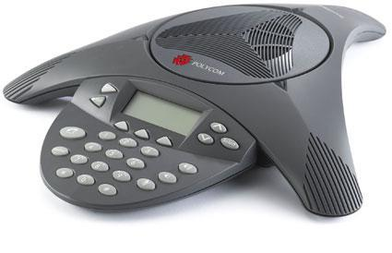
NHI Web Conference Training: Physical Concerns - When To Use Speakerphone
Notes:
For the best audio quality, use your telephone handset (always the cleanest sound) or a high quality headset. The conference bridge is made for virtual conversations.
Facilitator Note: Provide examples of high quality headsets that you would recommend to the class.

Slide 25
NHI Web Conference Training: Physical Concerns -Headset: Where Should the Microphone be Placed?
“Frank had a small pizza today.”
Notes:
Check the proper placement of the telephone microphone near your mouth.
Instructor Note: Open the poll pod Headset Placement question. Ask student to choose the best headset microphone placement. Once everyone as answered, broadcast the results.
For a headset, the best position is usually slightly below and to the side of your mouth (as in picture A).
Avoid blowing or popping into the mike. Have a colleague listen to your audio before the conference starts. Try this phrase: "Frank had a small pizza today." Listen for excessive breath on the F and H sounds, popping on the P and T sounds, and hissing on the S and Z sounds. If you hold your finger in front of your lips while saying this, you can feel the positions that have more and less breath pressure.

Slide 26
NHI Web Conference Training: Topic 4 - Vocal Technique
Physical Concerns
Audience Interaction
Instructor Delivery
Vocal Technique
Prep
Notes:
You’ve prepared your instruction, you’ve prepared your space and equipment, now let’s discuss what to do when actually delivering your presentation to the participants.
Here are tips for keeping your presentation and/or instruction style compelling and effective.

Slide 27
NHI Web Conference Training: Vocal Technique Speaking Keys: Presentation Voice
Energy
Passion
Relevance
Notes:
As a presenter, don’t worry as much about vocal pitch and cadence as about using your natural enthusiasm and passion for your subject. Your interest is infectious.
If you sound like you have given the information many times and are bored with it yourself, your audience will be bored. Remember to stress the relevance of your information for your audience.
A monotone lets your audience drift away from you. Include repeated changes in inflection, tone, volume, and speed to continuously refocus the audience on your voice. You’ll need to go “bigger” than you are used to and comfortable with in your normal personal conversation. When your voice carries the communication load, it needs to be overemphasized and larger than life to engage the listener.
Try listening to voiceover artists on radio commercials, television announcements, or even books on tape to get examples of how to punch up the enthusiasm for the message.
Facilitator Note: Provide an example of a radio ad. Bring up a Share Pod with the following link open in a web browser (there is no visual component): http://www.youtube.com/watch?v=ingJP0WSY70. Ask students for voice quality characteristics they noticed in the example.

Slide 28
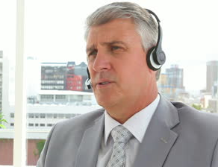
NHI Web Conference Training: Vocal Technique - Don’t Preface Sentences
Well…
So…
Okay…
Notes:
Instructor Note: Provide an example of what you have counted a word used by someone to preface their sentences, whether it was “well,” “so,” “okay,” “um,” or another culprit. Ask students if either they do this or have been in a class/presentation where this has happened. What was the experience like?
Some people start sentences with "Well...", "So..." or other phrases repeated incessantly. Eventually your audience starts counting the occurrences and ignoring what comes after your intro word.
The problem is, you cannot hear these yourself. You will likely need a coach to spot them and help work on eliminating them. In Module 5, you will have the opportunity to practice presenting. If you are in the habit of beginning sentences with a phrase like this, we can help make you aware that it is happening.

Slide 29
NHI Web Conference Training: Vocal Technique -
Use:
“We,” Our,” and the organization’s name
Avoid “I,” “me,” “my,” etc.
Notes:
Use “we,” “our,” etc., and the organization’s name, avoid “I,” “me,” “my,” etc.
When answering questions, reinforce key points from your presentation and avoid digressing to irrelevant points.
If necessary, paraphrase or ask for clarification if you don’t initially understand a question.
If you don’t know the answer to a question, say so and offer to do research to find the answer and then do it.
If appropriate, call on a participant/students knowledge and experience to answer a question.

Slide 30
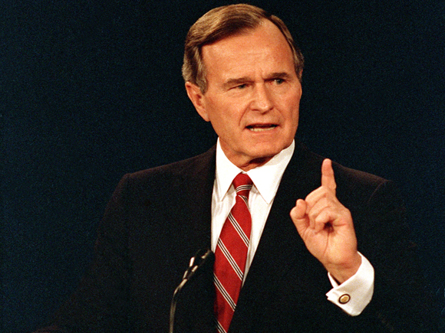
NHI Web Conference Training: Vocal Technique - Speak with Confidence, Be Declarative
Notes:
Confidence radiates out to an audience. You need to have a clear vision in your mind of your right to present the information and the benefits the audience will receive by listening to you.
Be declarative in your statements to give them more power. Watch out for qualifiers that soften your statements. “Pretty much”, “kind of”, “sort of”, and similar phrases do nothing to help you. Even when your audience does not notice them consciously, they subconsciously weaken your message.
A classic example is finishing by saying “That’s pretty much everything I wanted to tell you.” Either it is everything you wanted to tell them or you are leaving something out. Why introduce doubt in the listener’s mind?
Some political analysts say that six words helped George HW Bush win the US presidential election in 1988: “Read my lips… No new taxes.” The statement was confident and absolutely declarative, with no room for modifiers or qualifiers. The impact of presenting in this style is dramatic.
Instructor Note: Open the Be Declarative Notes Pod. Ask students to brainstorm additional examples of things they’ve heard presenters say that negate confidence. What are things they want to avoid saying/doing as instructors? On the flip side, what are things they can say to grab participants attention? (Example: “This is the most important thing I’m going to tell you in this class.”)

Slide 31
NHI Web Conference Training: Vocal Technique - Maintain Energy
Speak with your hands
Stand up and move around while you teach
Consciously smile
Do something to reinvigorate yourself
Work stories and anecdotes into your presentation
Don’t downplay content
Notes:
Over the course of a long course, you can easily let your energy flag. Watch out for a sigh while talking. This is a huge cue for the audience that the subject doesn't interest you, which means it shouldn’t interest them.
Tricks for maintaining energy in your voice include speaking with your hands. Let them fly! Stand up and pace while presenting. Consciously smile every now and then. Do something to reinvigorate yourself. If you are working stories and anecdotes into your presentation, these should help to re-interest you in your own
delivery.
Energy is also important within a single sentence. Don't let your voice drop off towards the end of a sentence. Every word you say should be important enough for the audience to listen to.
Remember that a change in vocal tone refocuses your audience's attention. So suddenly speeding up and dropping your voice has the opposite effect you imagine. It makes your audience pay more attention, not less.
If you need to skip over something or downplay it, don't sound apologetic or different from the rest of your presentation. "We can safely leave this for you to study on your own later. Let's move on to something I think you'll find very interesting..."

Slide 32
NHI Web Conference Training: Vocal Technique - Your Presence in the Conference Room
Notes:
Since the audience can't see you, your voice is the only thing they have to know that you are there and to build a sense of connection.
Instructor Note: Pause here to illustrate the effect. Give the students at least 5-10 seconds of silence.
Did you wonder if we had lost connection? As little as a three-second pause (if unexpected) can take your audience's focus off the material and onto thoughts of whether they have lost connection or lost the sound.
Think of yourself as a radio host who can't afford "dead air.“ If you do need to take a break for a sip of
water or to collect your thoughts, let your audience know that there will be a short silence.
Instructor Note: Discussion: What could you say if you know you need to pause, either to take a sip of water, find your notes for something, etc.?

Slide 33
NHI Web Conference Training: Topic 5 - Audience Interaction
Instructor Delivery
Prep
Physical Concerns
Vocal Technique
Audience Interaction
Notes:
Now that you have the tools to speak with energy and confidence, and keep your audience engaged, how do you really connect with them and draw them out? One way to do that is with well thought out questions.

Slide 34
NHI Web Conference Training: Audience Interaction - Rhetorical Questions
Some instructors slip in a rhetorical question…right?
Notes:
At the far end of the sentence some instructors slip in a rhetorical question, which may be an actual word, ("right?") or may be a questioning inflection.
Instructor Note: Provide an example sentence that ends in a questioning inflection or “right?” You could even repeat what you just said with the inflection: Some instructors slip in a rhetorical question…right?
Ending sentences on a question leads to frustration in your audience. You are implying that they should respond, but not letting them do so. Or, if you are in a presentation with open phone lines, some people may begin to respond, which is also disruptive and probably not your intent. You are trying to engage your audience, but this is not the way to do it.
Again, you will likely need help to note this and work on eliminating it, which we will get to in Module 5. Remember, Module 5 is meant to be helpful and supportive, so do not get concerned with the presentation. It is much better to be aware of and correct any bad habits than it is to continue to do them.

Slide 35
NHI Web Conference Training: Audience Interaction
Questions Anyone?????
Thoughtful??
Relevant?
Insightful?
Notes:
We just talked about how using rhetorical questions do not actually engage your audience. How then, can you positively interact with the audience and keep them connected with the course? Again, Questions…just not rhetorical ones.
What type of questions can add to the effectiveness of your WCT presentations?
An important part of being effective as an online presenter is learning how to work with your audience. That is more than just running online polls. Your delivery style can influence how they perceive you and the session as well. WCT Distance Learning can lose its effectiveness without the development of thoughtful, relevant questions and instructor‘s moderation of responses.

Slide 36
NHI Web Conference Training: Audience Interaction
Stimulating question
Brainstorm
Compare ideas
Fuse to curriculum
Notes:
The following guidelines are recommended to promote an important element; constructivist thinking, in the distance learning discussion and pedagogy:
Pose a stimulating question
Brainstorm answers to the question
Compare ideas and
Fuse to the curriculum

Slide 37
NHI Web Conference Training: Audience Interaction
Consider:
Cognitive levels of questions
Educational situation
Goals and objectives
Needs of students
Notes:
The first step in this process, is to pose a stimulating question. The question deserves special focus due to its important role in dictating the direction of the online discussion. As a result, it is recommended that instructors consider:
the cognitive levels of the questions
the educational situation
the goals and objectives of the instruction
the needs of the students when designing online discussion questions.

Slide 38
NHI Web Conference Training: Audience Interaction
Questions should be:
Interest-Arousing
Diagnosing
Recall Specific Facts
Notes:
A survey of the types of discussion questions used by online instructors revealed that the questions could be grouped into the following categories:
Interest-arousing and attention-getting questions: Example: “”If you awakened in the year 2399, what is the first thing you may notice?
Diagnosing and checking questions: Example: “Does anyone know Senge’s five principles of a learning organization?
Recollection of specific facts or information questions: Example: Who can name the main characters in Moby Dick?

Slide 39
NHI Web Conference Training: Audience Interaction
Questions can Be:
Managerial
Structure and redirect learning questions
Allow expression of affect questions
Notes:
Managerial questions: Example: “Did you request an extension on the assignment due date?
Structure and redirect learning questions: Example: “Now that we have discussed the advantages of and limitations to, formative evaluation, who can do the same for summative evaluation?
Allow expression of affect questions: Example: “How did you feel about our online guests list of ten things trainers do to shoot themselves in the foot?”

Slide 40
NHI Web Conference Training: Audience Interaction
Encourage higher level thought process questions
Manage student ideas
Facilitate student interactions
Summarize key points
Ask leading questions
Notes:
Encourage higher level thought processes questions: Example: “Considering what you have read and what was discussed in the posts this past week, can you summarize all of the ways there are to overcome obstacles to effective teamwork?”
During the discussion process, it is important that instructors continuously manage students’ ideas and further facilitate student interactions. However, if the online discussion is going well without instructor feedback, it is best for instructor to hold back from jumping into the discussion until the students’ responses begin to wane. At that point, it is recommended that instructors summarize key points that were made or ask prompting/leading questions to recharge the discussion.

Slide 41
NHI Web Conference Training: Audience Interaction – Effective Instruction
Project your voice
Be natural
Slow speaking voice
Pause
Know your audience
Main points… explain… summarize
Notes:
Effective Instruction
The following are practical suggestions to assist the Distance Instructor in effective instruction:
Project your voice; speak from your diaphragm rather than your throat.
Be natural; use a conversational tone of voice, only slightly louder.
Vary the speed of your voice for effect, slowing down or pausing for an important point helps to command attention.
Use terms your audience understands.
State your main points, explain them, and then summarize them.

Slide 42
NHI Web Conference Training: Audience Interaction – Effective Instruction
Speak to Each Individual, Not the Crowd
Dos
Don’ts
Do you know the answer to this question…?
Please type your first name into the console.
Take a moment to answer the poll question
Does anyone know the answer?
I’d like everyone out there to type their first name into the console.
Can everyone please answer the poll question?
Notes:
A key difference between in-room and web presentations is that the former creates an automatic sense of community. A person sitting at his or her computer does not feel connected to other audience members… Just to you. Take advantage of this by always phrasing your remarks to speak to the individual as if he or she was the only person on the line. The fact that you know there are 15 people listening is beside the point.
Instead of “Can anyone tell me the answer?” try “Do you know the answer?”
Instead of “I’d like everyone out there to type their first name into the console” try “Please type your first name into the console.”
The change is subtle yet powerful.

Slide 43
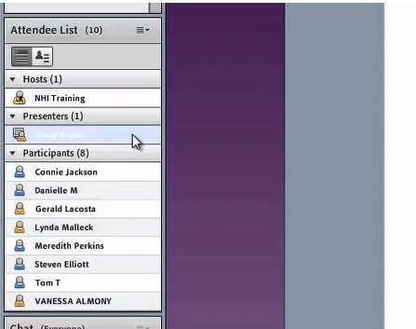
NHI Web Conference Training: Effective Instruction - Acknowledge Participants By Name
Need screenshot of Adobe Connect room with typical pods (share pod showing a PPT, Attendee List pod, notes pod with audio information, and chat pod with some chats – make it look like an in progress course).
Connie
Lynda
Tom
Notes:
Make use of first names in your audience. When someone asks a question or enters something into the chat pod, say the name of the person when you address the comment/question. Make reference to comments that people enter.
Talk to your audience conversationally, rather than in a declamatory fashion. You don't want them to think they are listening to a generic recording.
Be real and be yourself. Your personality goes a long way in engaging your audience.
Corey Question: Can you please provide a screenshot as described on the slide?

Slide 44
NHI Web Conference Training: Effective Instruction - Challenge Your Audience
Invite the audience to mentally participate in the discussion.
Notes:
Another trick of engagement is to invite the audience to mentally participate in the discussion. Instead of simply listing a set of facts, ask them if they have ideas about the topic and can make suggestions.
Web conferencing is much better for this than in-room presentations, as your audience can contribute through chat without slowing down or pulling focus, if needed. Or, a discussion can provide a much needed break from a lecture, and get students actively participating and speaking.

Slide 45
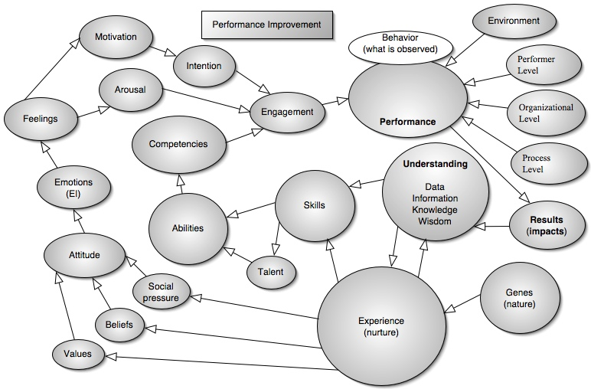
NHI Web Conference Training: Effective Instruction - Link Content To Purpose
Notes:
You should explicitly link facts and information back to your key concepts and purpose for the training. Don't assume that the audience will build the connection in their mind. They are assimilating new information they haven't seen before and it takes an extra cognitive step to understand why it is important or why they should care. Help them by making it clear as you go. This helps move the audience along with you at the same pace mentally.
Another way to help link content to purpose is to let participants practice or explore concepts on their own. Use the activities developed for the course to their full extent. Let students struggle to find answers, or at least to the point where they are asking good questions, and make sure you check in with students to be sure they understand what you are telling them. Further, try to make sure they are correctly applying the information as well. Debrief any activity or exercise as designed and ensure all students are with you before you move continue.

Slide 46
NHI Web Conference Training: Effective Instruction - Reinforce Key Points
Present information in a way that helps to reinforce key concepts.
Explain to participant how you apply information and why it is important.
Connect their daily life, job tasks, or other relevant activities to the content through examples and experience.
If possible, help students experience concepts in the course itself.
Notes:
"Is this going to be on the test?”
Your audience may not be that blunt, but they want help in knowing what are the most important items from all the material you throw at them. Help by occasionally reinforcing and highlighting the particularly important items.

Slide 47
NHI Web Conference Training: Summary
Prep
Physical Concerns
Vocal Technique
Instructor Delivery
Audience Interaction
Notes:
Presentation skills start before you begin speaking. Proper setup goes a long way towards making yourself comfortable and making your information more understandable. Prepare your content for maximum impact and purpose, prepare what you are going to say and practice until it becomes natural.
Set up your environment to give yourself a physical advantage.
Your vocal technique is the key to grabbing and holding your audience. It’s a learned skill set that requires practice.
Presenting to a remote audience is a new and unusual communication technique for many speakers. Bad habits will tend to creep in without you noticing. You will probably need help from a colleague or professional to make you aware of the speaking habits your brain has filtered out of your conscious notice.
And it’s important to continually reach out to your audience to keep a connection with them, practicing the little tricks that keep the audience moving along with you, and extending your presentation style right through the entire course.

Slide 48
Course Schedule
Module 1: Getting Started with Web Conference Training at NHI (WCT)
Module 2: How to Use Adobe Connect (WBT)
Module 3: Effective WCT Instruction (WCT)
Module 4: Preparing for an NHI WCT (WCT)
Module 5: Teachbacks (WCT)
Notes:
This completes Module 3: Effective WCT Instruction.
You should now know some tips and tricks to practice and apply to the WCTs you instruct to make them more engaging and effective.
Before we conclude for the day, let’s take a look at the remainder of the schedule for this course.
Next in Module 4, we discuss how to prepare for an NHI WCT. This refers to the using the Instructor Guide to help you set up the room and prepare for the course. Let’s pull up the schedule.
Facilitator Note: Open a Share pod with a document that provides an explanation of Modules 2-5, with dates, times, and assignments. Remind participants of the schedule.

Slide 49
NHI Web Conference Training: Module 3 - Conclusion
Instructor and host contact information is provide in the File Share pod.
Module 4 has been scheduled. Check your My Training page for scheduling information.
Remember that you can return to Module 2 any time if you need a refresher for how to use, set up, or reset a pod.
Notes:
The instructor and host contact information is provided in the Instructors.pdf document that you downloaded from the File Share pod.
Remember that because Module 2 is an asynchronous WBT, you can go back and review the content at any time. This might be helpful to you in the future as a refresher for how to set up, reset, or use a pod. We’ll be discussing some of these topics in Module 4 when we talk about setting up the course.
Facilitator Note: Open the File Share pod so that any students that did not download the Instructor.pdf document can do so now.

