Slide 1
Lesson 2: Applications for MLS Technology
By the end of this lesson, you will be able to:
Identify potential uses for MLS
Calculate accuracy levels for transportation applications
Decide if MLS is the right tool for your specific job
This lesson will take approximately 30 minutes to complete.
Notes:
Narration Notes:
Lesson 2 will help you determine how and when to use MLS technology.
Remember, you can press the Next button to continue and the Back button to go to the previous slide.

Slide 2
Potential Applications
Potential applications of MLS datasets include the following:
Research
Project Planning
Project Development
Construction
Maintenance
Operations
Safety
Asset Management
Tourism
On the following pages, you’ll have a chance to learn about applications from each of these categories.
Notes:
Narration Notes:
This section explains the many ways mobile LiDAR systems are used.
One of the key potential benefits of MLS is that a single acquired dataset can be used for a variety of applications.
The data can also be “mined” for additional information that may not have been a focus of the original acquisition.
For more on data mining, see Module 4: Data management.

Slide 3
Research Applications
Select the buttons at left to learn more about them.
Unstable Slopes
Coastal Erosion
Notes:
Narration Notes:
Click on the buttons to go to detailed explanation.

Slide 4
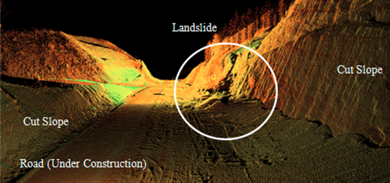

Research Applications: Unstable Slopes or Landslide Assessment
MLS can be used for: 1) Geotechnical monitoring of excavations and surrounding areas, which is critical in maintaining integrity; 2) Assessing the risk of slope instability (as shown in the image below); 3) Mapping geotechnical conditions of unstable slopes, including rock mass characterization, surficial slope stability, rockfall analyses, and displacement monitoring; and 4) Establishing a baseline for comparison.
Notes:
Narration Notes:
Slopes at risk of instability can be mapped to anticipate rock fall, displacement, and establish a baseline for comparison.

Slide 5
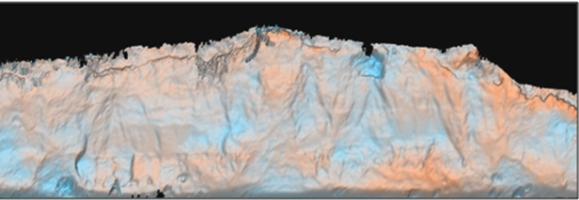
Research Applications: Coastal Erosion
Stationary scanning, using a stop-and-go approach, is useful along long coastal cliff sections. Its advantages over traditional methods of monitoring coastal erosion come from the density of the data points collected on the cliff faces. This allows for in-depth monitoring of accretion and excretion along the cliffs, as well as monitoring of large land mass movements.
Notes:
Narration Notes:
Stationary scanning shows erosion through monitoring accretion and excretion.

Slide 6
Project Planning Applications
Select the buttons below to learn more about project planning applications.
Roadway Analysis
Environmental Studies
Topographic Mapping
General Measurements
Notes:
Narration Notes:
Click on the buttons to go to detailed explanation.

Slide 7
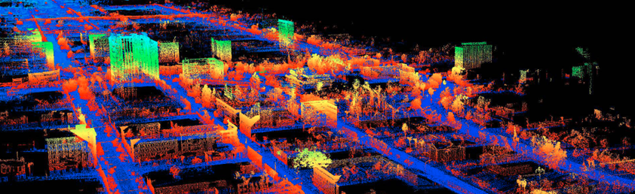
Roadway Analysis
MLS has been used to develop a roadway digital surface model, cross sections, and a highway interchange. The Grafe example (2008) in the Guidelines demonstrates how a controlled and guided roadway milling machine can be set to automatically cut the road using the digital surface model.
Notes:
Narration Notes:
A 2012 study shows how a vehicular model (derived from a static scan) can be used to evaluate the ability to navigate through a highway system that has been digitally captured through MLS.
See Guidelines, A.6.1.1.

Slide 8
Topographic Mapping
Topographic mapping is an important application of MLS, including earthwork computations. A comparative study conducted in 2003 showed only a 1.2 percent difference between the different laser scanning methods (ALS, TLS, and MLS), demonstrating that LiDAR can be a very efficient method of volumetric determination.
In 2011, researchers used a small, rigid hull, inflatable boat and a handcart designed to be pulled along by an individual to monitor topography and elevation changes along river corridors. The results showed that MLS provides accurate and precise change detection over the course of the study (one year), however, very careful control of systematic errors need to be accounted for. They note that the scanning field of view was often parallel to the topography, resulting in lower accuracy than scanning conducted perpendicular to the topography.
Notes:
Narration Notes:
In 2010 researchers evaluated the quality of pavement DTMs created from MLS data. They determined that although the technology does not currently meet Caltrans specification requirements, additional refinement of the technology should overcome this limitation in the near future.
See Guidelines, A 6.1.2.

Slide 9
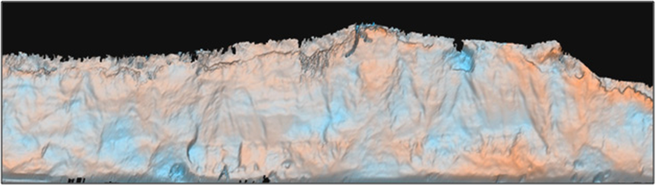
Environmental Studies
High resolution mapping provided by MLS can provide valuable location information for environmental assessments including locations and distribution of vegetation, rivers, slopes, manmade structures, and many other features of interest. In particular, the detailed topography provided by MLS is very useful for erosion assessments (See discussion on slope stability) as well as contaminant distribution modeling and analyses. Note that this is an emerging application of MLS.
Notes:
Narration Notes:
Using stationary images, high resolution gives details about topography.

Slide 10
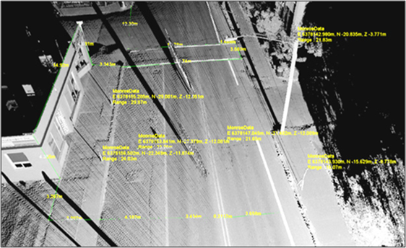
General Measurements
MLS provide a permanent record of site conditions that can be processed at any time after the initial collection of point data. This allows users to remotely measure length, volume, elevation, deflection, smoothness, camber, curvature, and more (Jaselskis et al., 2005).
This image shows how linear measurements in a point cloud can be used to find lane width, sidewalk width, and building dimensions.
Notes:
Narration Notes:
Collect a record of site conditions to collect measurements.

Slide 11
Project Development
Select the buttons below to learn more about project development applications.
Feature extraction for CAD models and baseline data
Virtual, 3D design of alternatives
Clash Detection
Notes:
Narration Notes:
Click on the buttons to go to detailed explanation.

Slide 12
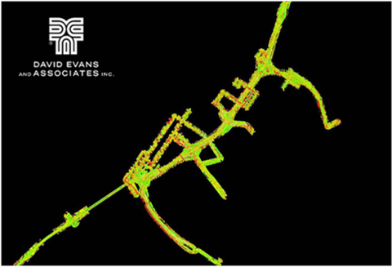
Feature Extraction for CAD Models and Baseline Data
Mobile LiDAR data are often converted to digital Computer Aided Drafting (CAD) models to serve as baseline information. Baseline data can be used for further construction development, including: slope stability near the roadway, intersection improvement projects, pavement quality monitoring, pavement volume calculation, roadway milling settings, and pre-accident condition data.
Notes:
Narration Notes:
This image shows MLS data used for planning and design purposes on the Columbia River Crossing Project between Oregon and Washington.
The North Carolina DOT used MLS to survey five sections of interstate highway to generate baseline that met engineering specifications. The acquisition was completed in 9 days compared to the estimated 50+ days needed for stationary laser scanning.
See Guidelines A.6.2.1.

Slide 13
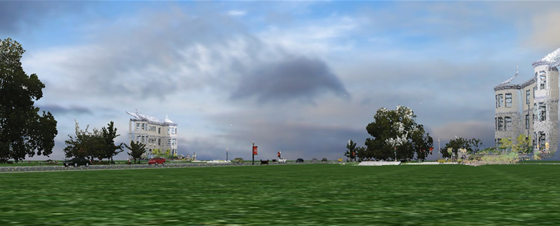
Virtual, 3D design of alternatives
A LiDAR point cloud allows designers to test various configurations in a virtual world that recreates the real world in high accuracy.
Notes:
Narration Notes:
The University of Wisconsin-Madison has utilized MLS to create a virtual world of the roadways surrounding the campus which is used in their driving simulator, allowing the simulator’s users to intimately connect the simulated environment with the real world.
See Guidelines, A.6.2.2.

Slide 14
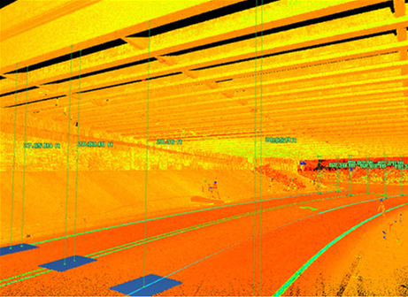
Clash Detection
Examples of clash detection include:
Providing clearance data (see image) for highway overpasses, bridges, traffic signs, and even roadside high power lines. These height clearances can be used to determine if a modeled object can navigate safely through the constricted section.
Notes:
Narration Notes:
Automated bridge clearance software is being used by Caltrans to document bridge clearances for 7,250 bridges.
The MLS-based automation is estimated to have saved 1.2 million manual mouse clicks.
In a comparison to traditional techniques, it showed superiority in speed of acquisition and removed the difficulty in trying to manually find the points of minimum clearance.
See Guidelines, A.6.2.3.

Slide 15
Construction Applications
Select the buttons below to learn more about construction applications.
Machine Control and Construction Automation
As-Built or Repaired Documentation
Post-Construction
Quality Control
Pavement Smoothness or Quality Determination
Quantities
Americans with Disabilities Act (ADA) Compliance
Notes:
Narration Notes:
Click on the buttons to go to detailed explanation.

Slide 16
Construction Applications: Machine Control and Construction Automation
A 2008 report discusses the way laser scanning enhances efficiency in machine automation for transportation applications.
Another from 2011 demonstrates an entirely digital site planning project.
Periodic scans with a MLS permit initial design, estimates of percent completion, project compliance, and as-builts at project completion.
Notes:
Narration Notes:
The 2011 report also discusses “Design to Dozer” a demonstration of construction automation hosted by Oregon DOT and the PPI Group depicting how MLS data can be used to create a Digital Terrain Model (DTM) for machine control and construction automation to grade a site without ever having to drive grade stakes. All grading is done entirely through equipment guided by GPS and a base model created from the 3D point cloud. This presents an opportunity for cost savings, time savings, and improves site safety. No-actual job studies or cost comparisons are currently available.
See Guidelines, A.6.3.1

Slide 17
Construction Applications: As-Built or Repaired Documentation
A 2008 report discusses the role of a living survey database through all stages of the infrastructure life cycle including planning, design, construction, and maintenance.
In addition, digital, as-built records provided by LiDAR can provide significantly more detail than traditional methods.
These digital records are particularly effective compared to traditional red lines on paper drawings.
Notes:
Narration Notes:
You can use LiDAR when documenting building projects through the entire building cycle and maintenance.
See Guidelines, A.6.3.2.

Slide 18
Construction Applications: Post-Construction Quality Control
In addition to providing high accuracy as-built records, MLS can provide quality control of the construction process.
A 2011 report discusses the use of algorithms for determining the flatness of concrete providing permanently documented results of the flatness defects, and permits users to remotely access the surface.
In 2008, researchers verified super-elevation slope values, curb design, and soundproofing wall design by creating cross sections of a roadway at 5m intervals.
The MLS data can then be compared to the original CAD drawings to ensure construction is completed within tolerance.
Notes:
Narration Notes:
The 2011 report also discusses “Design to Dozer” a demonstration of construction automation hosted by Oregon DOT and the PPI Group depicting how MLS data can be used to create a Digital Terrain Model (DTM) for machine control and construction automation to grade a site without ever having to drive grade stakes. All grading is done entirely through equipment guided by GPS and a base model created from the 3D point cloud. This presents an opportunity for cost savings, time savings, and improves site safety. No-actual job studies or cost comparisons are currently available.
See Guidelines, A.6.3.3.

Slide 19
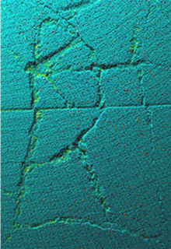
Construction Applications: Pavement Smoothness or Quality Determination
Data collected for roadways can be used for several
geometric analysis-including stopping sight distances,
adequate curve layouts, slope, super-elevation, drainage
properties, lane width, and pavement wear.
Specialized pavement laser profiling systems that use
similar technology to MLS can be used to evaluate
pavement condition including rutting, ride quality,
rehabilitation, texture, and automated distress. However,
typical MLS data acquisition may not be of sufficient
quality for these studies.
Notes:
Narration Notes:
The system was also effective in detecting cracks automatically; although scanner tilt angle, transverse profile spacing, and sampling frequency were key variables influencing the detection accuracy.
See Guidelines, A.6.5.1.

Slide 20
Construction Applications: Quantities
As in ALS and stationary TLS, topographic mapping is an important application of MLS, including earthwork computations. MLS data can be used to determine lengths, areas, volumes, and number of features for other quantities such as painted length of striping or areas of pavement patching.
For earthwork quantities, tops and some sides of stock piles may not be obtained with MLS due to visibility constraints. Stationary scanning can often be used to supplement.
A 2003 study compared total station and LiDAR-based volume calculations from stationary TLS. In this study, a 1.2 percent difference was calculated between the different methods, demonstrating that LiDAR can be a very efficient method of volumetric determination.
Notes:
Narration Notes:
Obtain documentation of material quantities with stationary scanning.

Slide 21
Construction Applications: Americans with Disabilities Act (ADA) Compliance
MLS data can be used to extract some information related to ADA compliance including location information as well as general measurements on features of interest such as widths of parking stalls, slopes of sidewalks, and dimensions of ADA ramps.
The guidelines also discuss advanced feature extraction techniques that will likely be implemented in the near future to automatically locate some of these features and extract necessary measurements.
Notes:
Narration Notes:
You can use MLS data to develop construction projects that adhere to the ADA.

Slide 22
Maintenance Applications
Mobile LiDAR can also be used for maintenance purposes. Many maintenance tasks are similar to those described under Construction. See that topic for more details. One key advantage is that mobile LiDAR could enable a rapid as-built, georeferenced record of maintenance that was completed, reducing the need for future, repeat surveys.
MLS is appropriate for the following maintenance applications:
Drainage / flooding
Vegetation management
Bridge inspections
Power line clearance
Notes:
Narration Notes:
Several maintenance issues are made easier by using LiDAR to capture data.

Slide 23
Operations Applications
Traffic congestion typically results from human error. Automakers are researching methods to remove much of the human component from driving. BMW has been developing a system called Traffic Jam Assistant to take over driving tasks when vehicle speed is lower than 25 mph. The system relies on GPS and LiDAR along with other components to perform steering, braking, and acceleration.
In 2012, researchers used mobile LiDAR to evaluate parking utilization along arterial roads at various times of the day. They propose mounting MLS units on public vehicles such as buses, which could collect daily datasets along specific routes.
Notes:
Narration Notes:
They also noted the potential for vehicle classification and parking duration from the repeat datasets. Comparison of the automated approach to ground truth showed a small error rate of 1/340 vehicles.
Other potential operations applications include:
Land use / zoning
Building Information Modeling (BIM)
Bridge Information Modeling (BrIM)
Emergency response
Clearances
See Guidelines, A.6.4.1.

Slide 24
Safety Applications
Select the buttons below to learn more about safety applications.
Unstable Slope Management
Forensics / Accident Investigation
Geometric Properties
Driver Assistance / Autonomous Navigation
Notes:
Narration Notes:
Click on the buttons to go to detailed explanation.

Slide 25
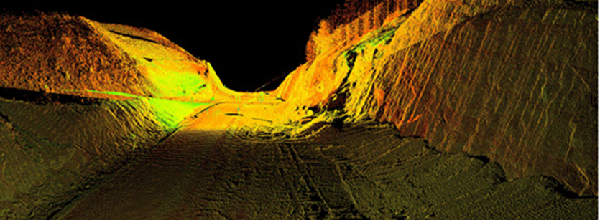
Safety Applications: Unstable Slope Management
In 2009, researchers demonstrated how rock fall hazards along transportation corridors can be monitored using MLS. For this study, the monitoring took place from both railway and roadway based MLS. In both situations, MLS provided increased efficiency and also the ability to monitor hazards in real-time. The safety benefits from real-time monitoring also extend beyond locating unstable rock hazards.
Notes:
Narration Notes:
Efficiency for managing unstable slopes is enhanced with real-time monitoring.

Slide 26
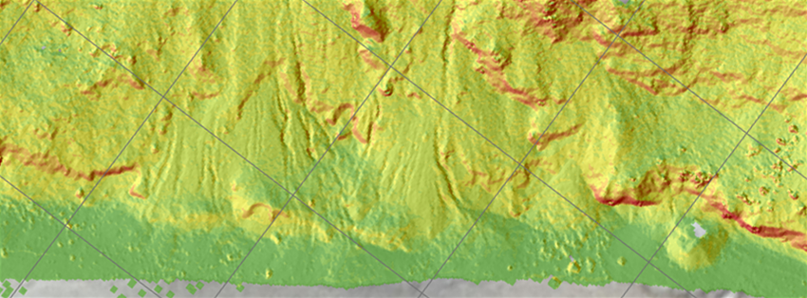
Safety Applications: Geometric Properties
Geometric properties such as grade, cross slope, characteristics of curves, lane widths, shoulder geometries, etc. can readily be queried from MLS data to support various types of safety analyses.
Notes:
Narration Notes:
Geometric properties are used in various types of safety analyses.

Slide 27
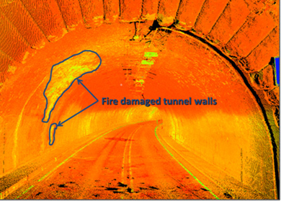
Safety Applications: Forensics / Accident Investigation
MLS is an emerging application for documenting accident scenes. Reports indicate it can make investigations 50% faster than stationary surveying, resulting in a 1.5 hour reduction in roadway closures. In addition, MLS can document pre-accident conditions and is a much faster way to document the long accident scenes that typically occur in high-speed crashes. It may also be used to analyze structural damage on bridge overpasses due to vehicle height exceeding the bridge clearance.
Notes:
Narration Notes:
MLS can rapidly scan networks of tunnels for damage inspection. However, the resulting accuracy depends heavily on the length of the tunnel and quality of the IMU because GNSS data is not available in the tunnel. This image shows an example of an intensity shaded laser scanning dataset obtained for a tunnel damaged by fire. Oregon DOT is planning to use their mobile LiDAR system to scan tunnels in Oregon on a repeat basis for structural monitoring.
See Guidelines, A.6.6.2.

Slide 28
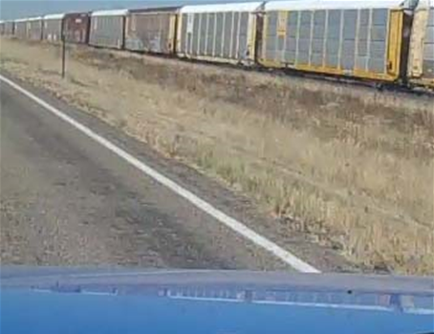
Safety Applications: Driver Assistance / Autonomous Navigation
Several 2009 reports discuss how MLS’s have begun to shape the research track of the autonomous vehicle navigation field. One predicts that autonomous vehicle navigation could be operational within the next decade. Another tests a simulated car, designed to model what a fully autonomous vehicle would be able to sense from a position on the roadway.
Notes:
Narration Notes:
This is done by automatically extracting poles (any vertical narrow structure), and then allowing the autonomous vehicle to calculate positioning based on the geometric arrangement of the poles. Pole extraction is performed on an already geo-referenced point cloud, and vehicle positioning calculated along the roadway based on referencing to the located poles. A 2006 report describes how laser systems on vehicles can be used to track curbs.
See Guidelines, A.6.6.3.

Slide 29
Asset Management Applications
Select the buttons below to learn more about asset management applications.
Billboard Management
Automated / Semi-Automated Extraction of Signs
Inventory Mapping
Notes:
Narration Notes:
Click on the buttons to go to detailed explanation.

Slide 30
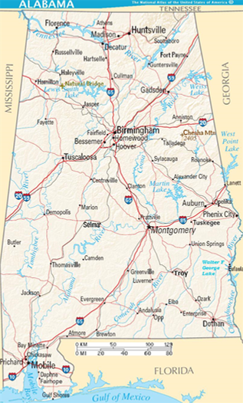
Asset Management Applications: Billboard Management
Alabama DOT also recently implemented mobile LiDAR for maintaining a billboard inventory and found it to be a cost-effective system. Many semi-automatic and automatic processes exist for extracting signs, that may be able to be adapted to extract billboards.
Notes:
Narration Notes:
Appropriate point cloud density may be difficult to achieve on a sign, however, imagery provides more detail and may be necessary, depending on the needs of the billboard management. Depending on the orientation of the scanner, some configurations will not actually capture both the front and backs of the signs.

Slide 31
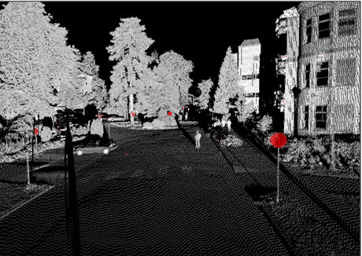
Asset Management Applications: Automated / Semi-Automated Extraction of Signs
Common features extracted from point cloud data include signs, streetlights or poles, reflective striping, and curbs. Please note that many of these procedures currently have only been tested on limited, test datasets and have not been integrated into mainstream software. However, current software is rapidly evolving to implement these novel techniques.
Notes:
Narration Notes:
Semi-automatic or fully automatic extraction of signs is necessary to efficiently locate signs in a large point cloud such as that provided by MLS. The image shown here provides an example of how the intensity values of the scanner can be used to identify reflective signage as part of a semi-automatic method for extraction and cataloging.
See Guidelines, A.6.9.3.

Slide 32
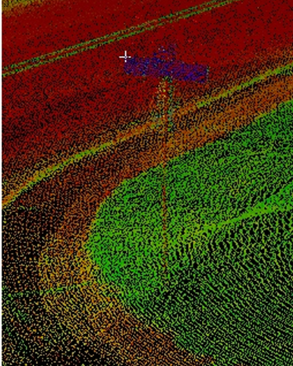
Asset Management Applications: Inventory Mapping
A 2005 report discusses inventory mapping as a secondary benefit of a point cloud. Inventory mapping can include any structure, pavement, signage, traffic signaling devices, etc. that can be extracted from a point cloud.
Notes:
Narration Notes:
A report from 2006 focuses on both manual and automated feature extraction. In addition to feature extraction, they also demonstrate the ability of software to automatically detect road signs and classify them by shape as defined by the Manual on Uniform Traffic Control Devices (MUTCD).
See Guidelines A.6.9.1.

Slide 33
Tourism Applications
Tourism is an emerging mobile LiDAR application. As tools to visualize point clouds from LiDAR systems become available, mobile LiDAR can provide a new generation of 3D, digital maps for navigation and exploration.
A 2009 report describes the efficiency gains possible with the acquisition of mobile LiDAR in the historic peninsula of Istanbul.
Only 80 ha (hectares) of the required 1500 ha were completed using static scanning in 6 months. The remaining 1420 ha were completed in 3 months using mobile LiDAR.
Notes:
Narration Notes:
Hectares is a term replacing the original measurement of acres. A hectare is a metric unit of square measure, equal to 100 acres (2.471 acres or 10,000 square meters).
The next few pages discuss the different levels of accuracy and data density (resolution) needed for various MLS applications.

Slide 34
Accuracy vs. Density
MLS applications require differing levels of accuracy and data density (resolution). For some applications, the local accuracy (i.e., relative measurements within the dataset) of the final point cloud is more important than the network accuracy (i.e., absolute positioning in a coordinate system). There is no “one size fits all” approach.
Example: MLS data acquired for bridge clearance calculations requires stringent local accuracy (to determine the bridge clearance), but the network accuracy of the point cloud (to determine bridge location) is not as critical.
Notes:
Narration Notes:
Recommendation: Agencies should take into consideration all potential uses when deciding on the level of accuracy and density for a specific project.
The following page contains an interactive exercise exploring accuracy/density for various types of transportation applications.

Slide 35
Suggested Accuracy Levels for Transportation Applications
Select a cell below to learn more.
Accuracy | High < 0.05 m (> 0.16 ft.) | Medium 0.05 to 0.20 m (0.16 to 0.66 ft.) | Low > 0.20 m (> 0.66 ft.)
Density | 1A | 2A | 3A
Fine > 100 pts/m² (> 9 pts/ft²)
 | 1B | 2B | 3B
Intermediate 30 to 100 pts/m² (3 to 9 pts/ft²)
 | 1C | 2C | 3C
Coarse < 30 pts/m² (< 3 pts/ft²)
High Accuracy/
Fine Density
Medium Accuracy/
Fine Density
Low Accuracy/
Fine Density
High Accuracy/
Intermediate Density
Medium Accuracy/
Intermediate Density
Low Accuracy/
Intermediate Density
High Accuracy/
Coarse Density
Medium Accuracy/
Coarse Density
Low Accuracy/
Coarse Density
Notes:
Narration Notes:
This activity explores the Data Collection Category (DCC) recommendations for nine different application categories based on the level of accuracy (1 = High, 2 = Medium, 3 = Low) and the level of point cloud density on the targets of interest (A = Coarse, B = Intermediate, C = Fine)
Higher levels of accuracy can lead to higher project costs, so this decision needs to be made wisely. Finer levels of point density are achieved by driving slower or making multiple passes. Note that these DCC categories (e.g., high) are relative to typical MLS capabilities and do not correspond to other acquisition technologies.
Click a selection in the table to see which applications require that combination of scanning accuracy and density.

Slide 36
Suggested Accuracy Levels for Transportation Applications
1A: High Accuracy/Fine Density applications
Engineering surveys
Digital terrain modeling (DTM)
Construction automation
Machine control
ADA compliance
Clearances
Pavement analysis
Drainage/flooding analysis
Virtual, 3D design
CAD models, baseline data
BIM/BRIM**
Post construction quality control
As-built/As-is/Repair documentation
Structural inspection
Notes:
Narration Notes:
1A refers to the cell in the original table you are exploring.

Slide 37
Suggested Accuracy Levels for Transportation Applications
2A: Medium Accuracy/Fine Density Applications
Forensics/Accident
investigation
Historic preservation
Power line clearance
Notes:
Narration Notes:
2A is the first cell on the second row in the table

Slide 38
Suggested Accuracy Levels for Transportation Applications
3A: Low Accuracy/Fine Density applications
Roadway condition assessment general
Notes:
Narration Notes:
Assessing roadway conditions is an application for low accuracy/fine density data.

Slide 39
Suggested Accuracy Levels for Transportation Applications
1B: High Accuracy/Intermediate Density Applications
Unstable slopes
Landslide assessment
Notes:
Narration Notes:
Hi accuracy data can be used on unstable slopes.

Slide 40
Suggested Accuracy Levels for Transportation Applications
2B: Medium Accuracy/Intermediate Density Applications
Emergency response
Planning
Land use/Zoning
Urban modeling
Traffic
Automated/Semi-automatic extraction of signs and other features
Safety
Environmental studies
Notes:
Narration Notes:
Medium accuracy data has a wide range of usages.

Slide 41
Suggested Accuracy Levels for Transportation Applications
3B: Low Accuracy/Intermediate Density Applications
Asset management
Inventory mapping (e.g., GIS)
Virtual tourism
Notes:
Narration Notes:
Listed issues are managed using low accuracy/intermediate density data.

Slide 42
Suggested Accuracy Levels for Transportation Applications
1C: High Accuracy/Coarse Density Applications
Quantities (e.g., earthwork)
Natural terrain mapping
Notes:
Narration Notes:
Earthwork and natural terrain mapping benefit from high accuracy/coarse density data.

Slide 43
Suggested Accuracy Levels for Transportation Applications
2C: Medium Accuracy/Coarse Density Applications
Vegetation management
Notes:
Narration Notes:
Vegetation management is an important part of maintaining an area.

Slide 44
Suggested Accuracy Levels for Transportation Applications
3C: Low Accuracy/Coarse Density Applications
Emergency response
Planning
Land use/Zoning
Urban modeling
Traffic
Notes:
Narration Notes:
Low Accuracy/Coarse Density applications include emergency response.

Slide 45
Is MLS Right For Your Project?
Issues to consider when determining whether MLS is right for your project:
MLS is just one tool, and it is not always the best one.
MLS is useful when data is needed quickly based on scheduling constraints.
It’s important to perform a cost benefit ratio analysis to determine if MLS is the optimal technological approach for a specific project.
Notes:
Narration Notes:
A cost benefit analysis includes:
Accounting for all potential uses of the data during its lifespan
Estimating the workload needed to perform quality control and certification
Deciding how the data will integrate into existing workflows and determining what workflows would need to be improved and/or updated
Understanding the ability to share the data (and costs) both within the transportation agency and outside of the transportation agency
Incorporating both resolution and accuracy needs
Considering additional data that can be acquired from the same collection platform
See Module 3: Mobile LiDAR Procurement for a more detailed discussion of these and other topics related to determining if MLS is appropriate for your organization.

Slide 46

Knowledge Check 2
Notes:
Narration Notes:
Click Next to start the knowledge check.

Slide 47
Drag and drop to match the term with the definition.
Term
Definition
A
Network Accuracy
A.
Relative to an established datum
B
Local Accuracy
B.
Between nearby points within the point cloud
C
Density
C.
Number of points per unit area
Correct. Advance to the next slide for a debrief. Select anywhere to continue.
Incorrect. Advance to the next slide for a debrief. Select anywhere to continue.
Your answer:
You answered this correctly!
You did not answer this question completely
You have provided an incomplete answer. Select anywhere to try again.
The correct answer is:
Submit
Clear
Notes:
Narration Notes:
Click anywhere on the slide to continue.

Slide 48
Debrief: Terms and Definitions
Network Accuracy: Relative to an established datum
Local Accuracy: Between nearby points within the point cloud
Density: Number of points per unit area
Notes:
Narration Notes:
Debrief the question by reading the answers provided on the slide.

Slide 49
Which of the following is an example of an application where local accuracy would be more important than network accuracy in scanning?
A)
Determining the clearance under a bridge
B)
Performing change detection
C)
Inventory mapping
D)
Digital terrain modeling
E)
Land use/zoning
Correct. Advance to the next slide for a debrief. Select anywhere to continue.
Incorrect. Advance to the next slide for a debrief. Select anywhere to continue.
Your answer:
You answered this correctly!
You did not answer this question completely
You have provided an incomplete answer. Select anywhere to try again.
The correct answer is:
Submit
Clear
Notes:
Narration Notes:
Click anywhere on the slide to continue.

Slide 50
Debrief: Which of the following is an example of an application where local accuracy would be more important than network accuracy in scanning?
[correct] Determining the clearance under a bridge
[incorrect] Performing change detection
[incorrect] Inventory mapping
[incorrect] Digital terrain modeling
[incorrect] Land use/zoning
Notes:
Narration Notes:
Debrief the question by reading the answers provided on the slide.

Slide 51
Which of the following should be part of a cost benefit analysis when determining if MLS is right for a project? (Select all that apply.)
A)
Accounting for all potential users of the data during its lifespan
B)
Considering additional data that can be acquired from the same collection platform
C)
Determining what workflows would need to be improved or updated
D)
Estimating the workload needed to perform quality control and certification
Correct. Advance to the next slide for a debrief. Select anywhere to continue.
Incorrect. Advance to the next slide for a debrief. Select anywhere to continue.
Your answer:
You answered this correctly!
You did not answer this question completely
Incorrect. Select anywhere to try again.
You have provided an incomplete answer. Select anywhere to try again.
The correct answer is:
Submit
Clear
Notes:
Narration Notes:
Click anywhere on the slide to continue.

Slide 52
Debrief: Which of the following should be part of a cost benefit analysis when determining if MLS is right for a project? (Select all that apply.)
[correct] Accounting for all potential users of the data during its lifespan
[correct] Considering additional data that can be acquired from the same collection platform
[correct] Determining what workflows would need to be improved or updated
[correct] Estimating the workload needed to perform quality control and certification
Notes:
Narration Notes:
Debrief the question by reading the answers provided on the slide.

Slide 53
Lesson Summary
You are now able to:
Identify potential uses for MLS
Calculate accuracy levels for transportation applications
Decide if MLS is the right tool for your specific job
Notes:
Narration Notes:
Now you have more knowledge of how to apply the MLS technology.
Click on the Next button to continue to Lesson 3.

